Slide 1


December 3rd
Lakeland-Census Data Integration
Vasant Saladi, Irfan Mushfique, Yonas Tewachew, Micah Seghetti, Joseph Louis

Slide 2
Background
Agenda
Overview of Project Tasks/Deliverables
Database Design Process
Overview of Database
Future Use
01
02
03
04
05

Slide 3
Background
01

Slide 4


Background
A database is an organized collection of data stored electronically. Here, a database will serve as an organized electronic library containing data points that document the Lakeland community leading up to when the community was hit by discriminatory practices such as redlining. In order to raise awareness and properly document the community as whole, it was imperative that it was done so in a methodical, organized manner.
A database is an organized collection of data stored electronically. Here, a database will serve as an organized electronic library containing data points that document the Lakeland community leading up to when the community was hit by discriminatory practices such as redlining. In order to raise awareness and properly document the community as whole, it was imperative that it was done so in a methodical, organized manner.
Why Create a Database?
Database Overview: Organized collection of Lakeland's historical data.
Purpose: Raise awareness and document the community.
Significance: Preserve Lakeland's history and context.

Slide 5
Overview of Project Tasks/Deliverables
02

Slide 6

Big Picture: Document Lakeland's residents before redlining.
Research: Study census/public records handling.
Analysis: Identify key entities and attributes.
Design: Create database schema and relational database.
Documentation: Record every step and produce a final report.
6

Slide 7
Database Design Process
03

Slide 8

⬤ Identified Key Entities and Attributes
⬤ Data Normalization
⬤ ERD Creation
⬤ Data Schema

Slide 9
Overview of Database
04

Slide 10
Using the data schema, we created a database in Supabase that will be accessible and usable past this semester

Slide 11
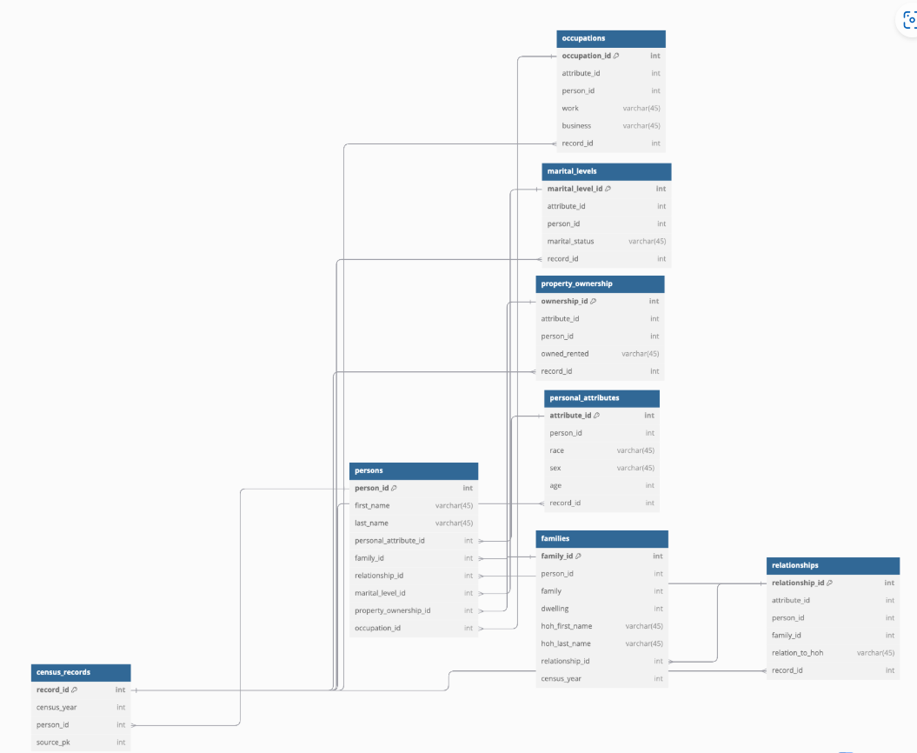

Slide 12
Final Report

Slide 13
The final report provides a comprehensive overview of the work we have done throughout the semester. Ultimately, we intend for this to serve as handover documentation to whoever will be responsible for maintaining the work we have done this semester.

Slide 14
Future Use
05

Slide 15

Research Focus: Explored future applications of our work.
Use Case: Identified potential use in government reparations for Lakeland residents.
Impact: Database could help determine eligibility for reparations.

Slide 16
Questions?

